Slide 1

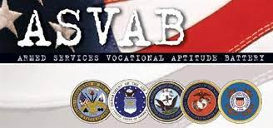

Let’s Talk ASVAB!
A FlipSetter Academy presentation on:
What the test is all about
How the test works
Common misconceptions and Points of View
How its concepts are lifelong skill builders

Slide 2






ASVAB
Armed Services Vocational Aptitude Battery Test
Before FlipSetter Academy With FlipSetter Academy
We will transition you from Impossible to Incredible!
Let’s Connect!
“Success is what we define it to be. We can only control our own outcome, and by doing so education is the difference between a good decision and the best decision…”
- Sabaresh Krishnan, Founder of FlipSetter Academy

Slide 3


What is the ASVAB?
The ASVAB stands for Armed Services Vocational Aptitude Batter test. Local military recruitment offices administer it.
Who takes the ASVAB?
It’s a national exam taken by high school students (pre-military) and post military personnel interested in military careers.
Why is it important?
It requires the bare minimum skillsets scholastically to help transition from high school to recruitment, or post military to enter professional development into the military workforce.

Slide 4
Is the ASVAB hard?
It can be challenging for some students. With the right program, expert instructors and an easy to use system, you can win. Without proper preparation you’re going to lose.
How do you get a good score?
Look for a trusted program i.e. Princeton Review, Kaplan, FlipSetter Academy that specializes in this niche test that millions of students take every year. We are all industry experts for this test
What are the benefits?
Have colleges scout you out and pay for you!
Standing out from the masses with a high score
Making you feel smarter & gaining confidence
Explore rewarding military careers and adventurous pathways

Slide 5
Point of View 1 -
“I plan on going into the military, so the bare minimum GPA is more than enough to get by. I don’t see a need to score high on the ASVAB or increase my GPA.”
Tutor – It is your decision to choose a path that’s not scholastically heavy. However, when dealing with intelligence, briefing, helicopters, Humvees and other expensive, military equipment you’ll still NEED a certain aptitude level. Otherwise, the ASVAB wouldn’t be required.

Slide 6
Point of View 2 -
“I’m not planning on going to college. I’m going enlist in the military, have them pay for my schooling, so entrance exams don’t apply to me.”
Tutor - The ASVAB is STILL a military entrance exam. It’s not the SAT, but STILL requires a score. It STILL contains essential math, reading, writing and science skills needed to enlist. When you do master these skills, the values will speak for themselves!
Think outside the box!

Slide 7
Point of View 3-
“Ok, so I decided to study for the ASVAB. I’m in the military now. I don’t need these skills anymore, so what was the point?”
Tutor - Generally, military personnel who look for employment (post-military) whether it be a career in the military or as a civilian, you’re STILL expected to uphold educational and professional standards. For military careers, you are STILL required to have an ASVAB score. So, you STILL can’t avoid fundamental knowledge.

Slide 8
What is tested on the ASVAB?
EL - Electronics: GS+AR+MK+EI FA - Field Artillery: AR+CS+MK+MC
GM - General Maintenance: GS+AS+MK+EI GT - General Technical: AR
MM - Mechanical Maintenance: NO+AS+MC+EI ST - Skilled Technical: GS+MK+MC
OF - Operators and Food: NO+AS+MC SC - Surveillance and Communications: AR+AS+MC
Subtests:
GS – General Science AR – Arithmetic Reasoning
WK – Word Knowledge PC – Paragraph Comprehension
MK – Math Knowledge EI – Electronics Information
AS – Auto and Shop Information MC – Mechanical Comprehension
For more information, please visit - https://www.flipsetteracademy.com/asvab

Slide 9
Where can I take the ASVAB?
Tests can be taken at your nearest military recruiting office:
- Army, Marines, Airforce, Navy and Coast Guard
How much does it cost to take the ASVAB?
There is no fee to take the ASVAB
How many times should I take it?
It is recommended that you limit your ASVAB to a maximum of three attempts. The ASVAB can be taken for military enlistment and post-military (military careers)
You can do it right the first time, with us!

Slide 10
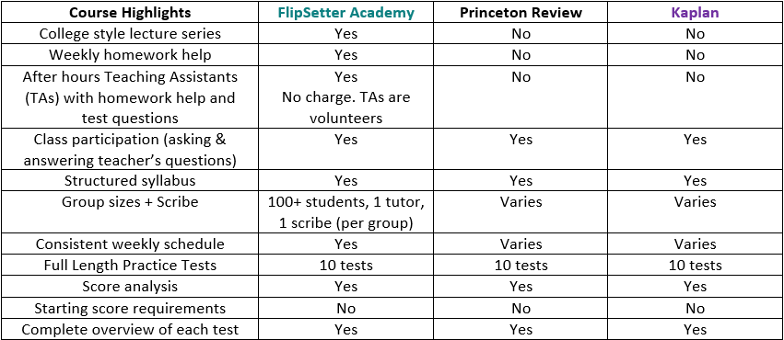
Who offers ASVAB lessons?
Because the ASVAB is a vocational test and not scholastic based, very few brand named testing companies
provide ASVAB training:
Visit us at www.flipsetteracademy.com to learn more, and see how you can join our ASVAB classes On Demand!

Slide 11
While there are many out there, we recommend you to join us!
Why? Because at
FlipSetter Academy
You can do it right the first time and final time
A professional tutor can make all the difference in your life. Your first step to a successful college career starts with a simple phone call or email to FlipSetter Academy – “your score to a brighter future!”
www.flipsetteracademy.com

