Slide 1

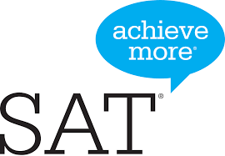
Let’s Demystify the SAT
A FlipSetter Academy presentation on:
What the test is all about
Thinking beyond the test
How to use its concepts outside of school
How its concepts are lifelong skill builders

Slide 2







The SATs…
Scholastic Aptitude Test
Before FlipSetter Academy With FlipSetter Academy
Let’s demystify them
We will transition you from Impossible to Incredible!
Let’s Connect!
“Success is what we define it to be. We can only control our own outcome, and by doing so education is the difference between a good decision and the best decision…”
- Sabaresh Krishnan, Founder of FlipSetter Academy

Slide 3

What is the SAT?
The SAT stands for Scholastic Aptitude Test. It’s issued by the CollegeBoard¹ and is an option for students to stay competitive above and others to continue on the path to success.
Who takes the SAT?
It’s a national exam taken by high school students in grade levels 10th, 11th and 12th .
Students submit their scores to get into college, top ranked universities and can earn the best scholarships (FREE COLLEGE ADMISSIONS!)
Why is it important?
It’s been proven by scholars and researchers that the SATs help play a major role in the development of a student transitioning from high school to college, and succeeding professionally.
1 - https://collegereadiness.collegeboard.org/sat

Slide 4
Is the SAT hard?
Yes, it can be challenging. With the right program, expert instructors and easy to use system, you can win. Without proper preparation you’re going to lose.
How do you get a good score?
Look for a trusted program i.e. Kumon, Princeton Review, Kaplan, FlipSetter Academy that specializes in this niche test that millions of students take every year. We are all industry experts for this test
What are the benefits?
Getting into the college of your choice
Standing out from the masses with a high score
Making you feel smarter & gaining confidence
A high score equals access to great scholarships

Slide 5

Myth 1 -
I have a high GPA (3.8), or I am going to be the Valedictorian of my high school, so my SAT score should already be in the top 10% (1400 +)
SAT Expert – A high GPA DOES NOT correlate to a high SAT score. They are completely different. That is why there are school teachers and there are SAT tutors. Both have their expertise.
Hmm…my dream is a 1600 on the SAT! I should contact FlipSetter Academy and join!

Slide 6



Myth 2 -
“I have all A’s on my report card for reading, writing and math, so I will obviously get a high score on the SAT.”
SAT Expert - Straight A’s has nothing to do with your SATs. You may learn faster, score higher quicker, but you still need an SAT tutor. The SAT is designed to be a skill builder…that’s why it’s called an “APTITUDE” test.
Think outside the box!

Slide 7
Myth 3 -
“I won’t be using the knowledge I gained from the SATs in College or in a career because they are no longer relevant.”
SAT Expert - Again, this is why it’s called an Aptitude test. Your aptitude in college, job interview and in your career is always challenged. Keep yourself elevated above others.
All jobs use SAT concepts in different forms – lawyers, doctors, engineers, investment bankers, business professionals, athletes, and more

Slide 8
What is tested on the SAT?
Reading, Writing and Math
- Section 1 – Reading (basic ability to decipher what other people have accomplished and shows you a path to success.) 65 minutes, 52 questions
- Section 2 – Writing (express your thoughts, emotions and dreams; and to motivate others to follow you. Transition from a follower to a leader) 35 minutes, 44 questions
- Section 3 & 4 – Math (it’s the language of the future. It powers the next generation)
Section 3 (25 minutes, 20 questions) Section 4 (55 minutes, 38 questions)
Total time length: 180 minutes (3 hours) Total number of questions: 154 questions

Slide 9
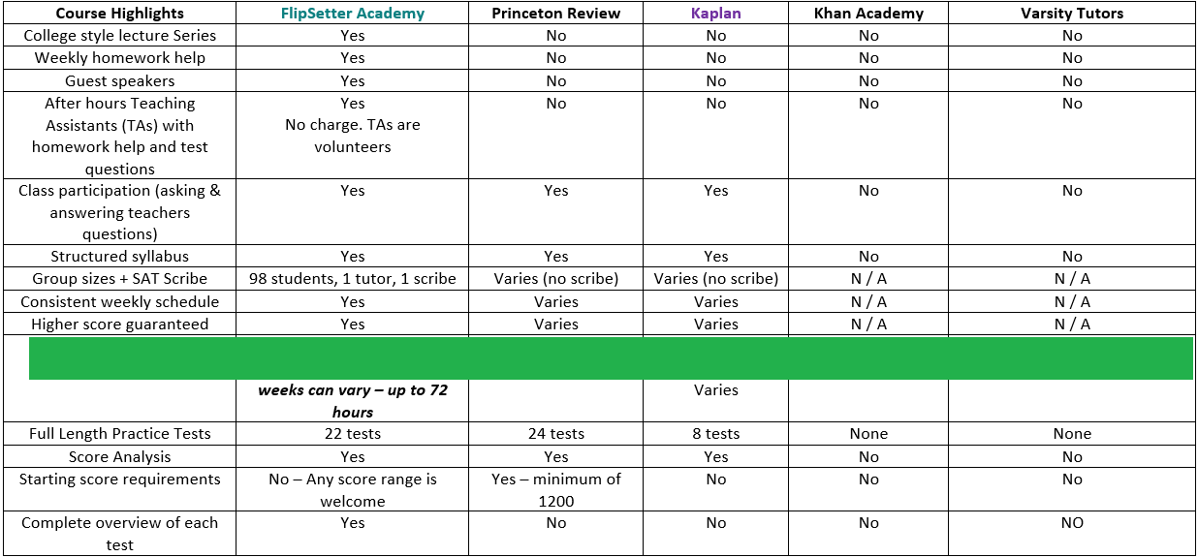
Who offers SAT lessons?
There are many trusted programs available:
These SAT “schools of though follow the same format –
Section 1 – Reading Comprehension Section 2 – Writing
Section 3 – Math (without calculator) Section 4 – Math (with calculator)
Others resources
include Kumon, YouTube,
Private tutor, etc.

Slide 10
Where can I take the SAT?
Tests can be taken at testing centers – Pearson testing facilities. For more information, consult with the College Board² so they can tell you where the next testing location is.
How much does it cost to take the SAT?
The cost for the SAT each time is $52
How many times should I take it?
It is recommended that you limit your SAT to a maximum of three attempts. The less number of attempts (1st or 2nd) makes you more impressive!
You can do it right the first time, with us!
2- https://collegereadiness.collegeboard.org/sat

Slide 11




Unlock your scholarship catalog with a high score!
Updated For Year 2021
Scholarships are the highest benefit. Your score is your trump card to unlimited possibilities:
- Tap into unlimited scholarships
    Bright Futures Scholarship (starting at 1210)
    Eagle Scout scholarship (starting at 1290)
    ROTC (starting at 1000)
    National Merit Scholarship (Florida range 214 – 219 PSAT)
    And more…UNIGO, FastWeb, Scholly, etc.
- Universities will pay you to attend (1450+)
- Extend 100% tuition coverage beyond undergrad
      Undergrad + Graduate school (1550+)
The possibilities are endless!
Your score can lead to college and trade school savings of $150,000+. No need to spend the next 5-8 years paying everything off with college loans

Slide 12
While there are many out there, we recommend you to join us!
Why? Because at
FlipSetter Academy
You can do it right the first time and final time
A professional tutor can make all the difference in your life. Your first step to a successful college career starts with a simple phone call or email to FlipSetter Academy – “your score to a brighter future!”
www.flipsetteracademy.com

